Slide 1
Programming Enterprise Components
Setting Data Source in Wildfly to connect MySQL

Slide 2
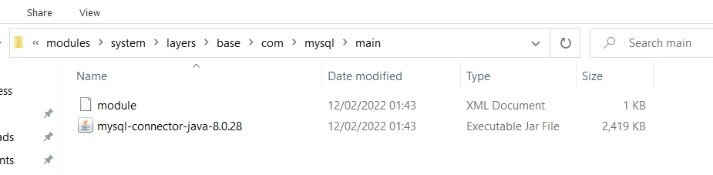
Setting up a Data Source in WildFly
Step 1: Place mysql folder (downloaded from Week 5) at
[wildflyHome]\modules\system\layers\base\com

Slide 3
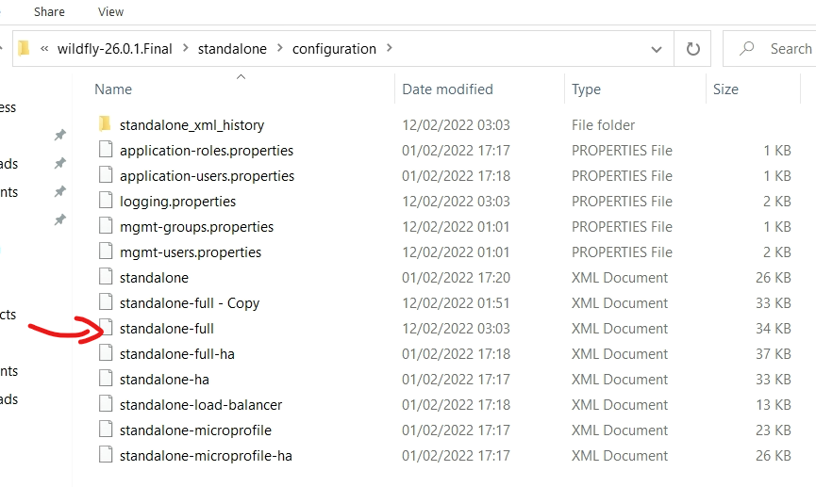
Setting up a Data Source in WildFly
Step 2: Find the standalone-full.xml configuration file

Slide 4
Setting up a Data Source in WildFly
Search for the <drivers> section in the standalone-full.xml file and add:
<driver name="mysql" module="com.mysql">
<driver-class>com.mysql.cj.jdbc.Driver</driver-class>
<xa-datasource-class>com.mysql.cj.jdbc.MysqlXADataSource</xa-datasource-class>
</driver>

Slide 5
Setting up a Book Store Data Source in WildFly
Add the following code in the standalone-full.xml file in the <datasources> section
<datasource jndi-name="java:/BookStoreDS" pool-name="BookStoreDS">
<connection-url>jdbc:mysql://mysql.cms.gre.ac.uk/xxxxx</connection-url>
<driver-class>com.mysql.cj.jdbc.Driver</driver-class>
<driver>mysql</driver>
<security>
<user-name>xxxxx</user-name>
<password>xxxxx</password>
</security>
<validation>
<valid-connection-checker class-name="org.jboss.jca.adapters.jdbc.extensions.mysql.MySQLValidConnectionChecker"/>
<validate-on-match>true</validate-on-match>
<exception-sorter class-name="org.jboss.jca.adapters.jdbc.extensions.mysql.MySQLExceptionSorter"/>
</validation>
</datasource>
Replace with your database
Replace with your username & password

Slide 6
The End

